Slide 1
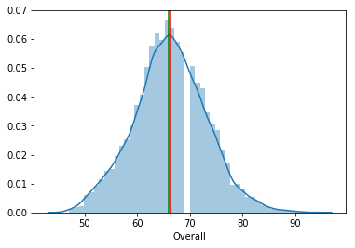
Distribution of Overall for all players :
Most of the players have an overall rating between 60 to 70

Slide 2
Top 20 players whose contract expires in 2020 :
1. De Gea
2. E. Hazard
3. L. Modrić
4. Sergio Ramos
5. David Silva
6. E. Cavani
7. G. Chiellini
8. C. Eriksen
9. Thiago Silva
10. K. Navas
11. Jordi Alba
12. D. Mertens
13. M. Hamšík
14. Alex Sandro
15. T. Alderweireld
16. M. Benatia
17. Fernandinho
18. N. Fekir
19. Parejo
20. E. Džeko
The average wage expected to be paid to these set of players is
around €9278.13
The average age of these set of players is around is 25 years
Higher the Overall for the players, higher will be their Value for
The team.

Slide 3
Top 5 players by Overall rating for each unique position
There are a total of 27 positions in football where the various players have played throughout their career.
Also, There are no players who have played at two different positions.

Slide 4
Top player at every position table :
Player Name | Position | Mean Wage of Top5 players
Cristiano Ronaldo | ST | 294000.0
De Gea | GK | 192800.0
D. Godín | CB | 139600.0
Thiago | CM | 130600.0
Marcelo | LB | 177200.0
Azpilicueta | RB | 155400.0
K. Mbappé | RM | 131400.0
P. Aubameyang | LM | 164600.0
A. Griezmann | CAM | 174000.0
Sergio Busquets | CDM | 217000.0
Sergio Ramos | RCB | 231000.0
G. Chiellini | LCB | 162000.0
K. De Bruyne | RCM | 240800.0
Continued…

Slide 5
Player Name | Position | Mean Wage of Top5 players
T. Kroos | LCM | 184400.0
Bernardo Silva | RW | 202000.0
Neymar Jr | LW | 261000.0
P. Pogba | RDM | 105000.0
N. Kanté | LDM | 126600.0
L. Suárez | RS | 132200.0
E. Cavani | LS | 130200.0
M. Ginter | RWB | 44200.0
N. Schulz | LWB | 34200.0
Luis Alberto | CF | 47400.0
E. Hazard | LF | 121200.0
J. Cuadrado | RAM | 45400.0
J. Rodríguez | LAM | 81600.0
L. Messi | RF | 148000.0

